Slide 1
0x503 – Data Dependent Leakages
ECED4406 – Computer Security
Dr. Colin O’Flynn
Dalhousie University.

Slide 2
But Why???
We saw these power differences – where is it coming from? Is it all just instruction differences?

Slide 3
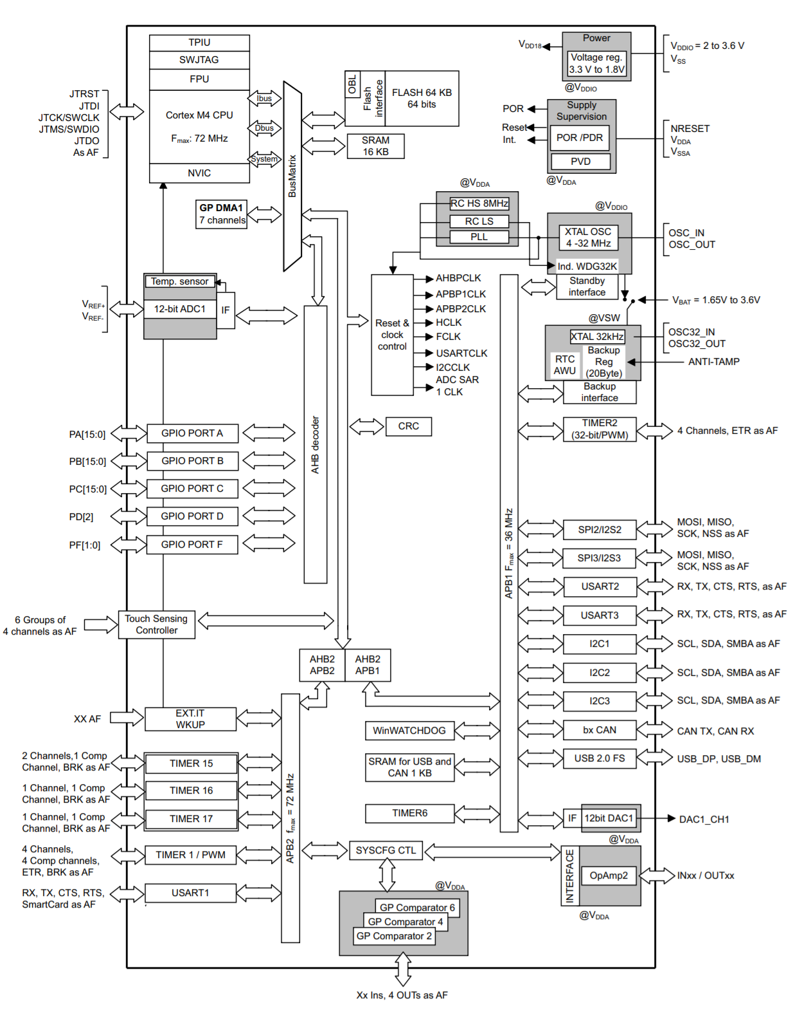
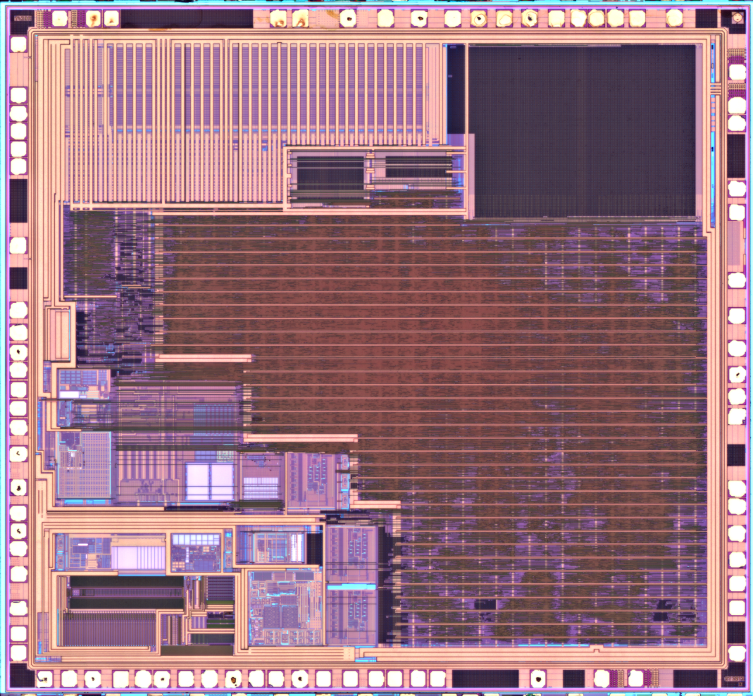
STM32F302 – Microcontroller Example
Source: Texplained, download more images
from https://www.texplained.com/ressources/

Slide 4
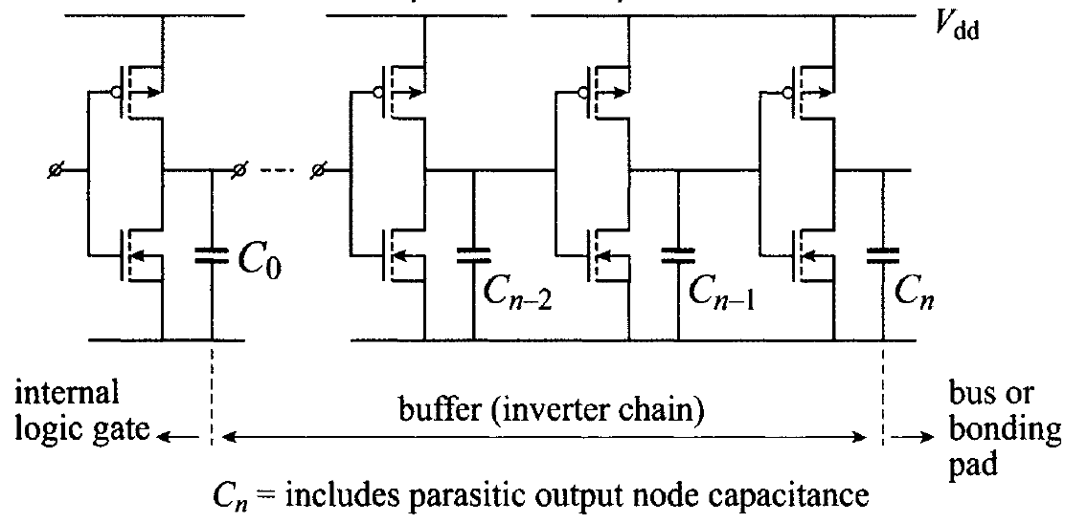
Driving Busses?
Example of design of buffer showing some considerations required. From book “Nanometer CMOS ICs: Basics to Asics” by H. Veendrick.

Slide 5
Driving Busses = Power

Slide 6
Sources of Data-Dependent Power Leakage
1. Charging / discharging of bus capacitance.
2. Shoot-through / crowbar current.
3. Changing registers holding state.

Slide 7
Summary so far
The actual data being processed results in differing amounts of power, something we can physically measure.
How do we test a system for such leakage? We can reuse our statistical test to do so, which we introduced with another form of leakage (timing).
But what would this leakage be used to attack – let's look at this first.

Slide 8
Time-Independent Password Check
uint8_t diff = 0;
for (size_t i = 0; i < len; i++) {
uint8_t x = guess[i] ^ secret[i];
diff |= x;
}
return diff == 0;

Slide 9
DPA Demo
https://colab.research.google.com/drive/1npVP9X2UCyTUp2u3kytnY1hbyunMEy-5?usp=sharing

Slide 10
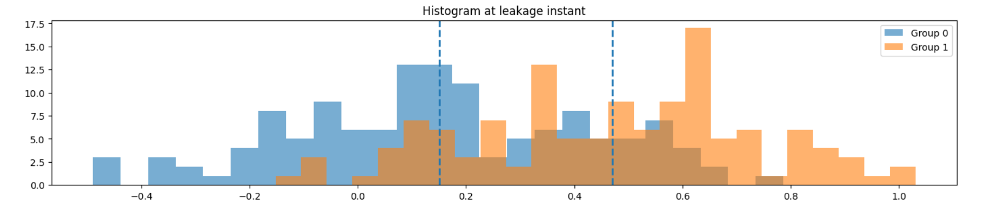
If we split power traces based on input bit, and assume we have an XOR:

Slide 11
Histogram over Time

Slide 12
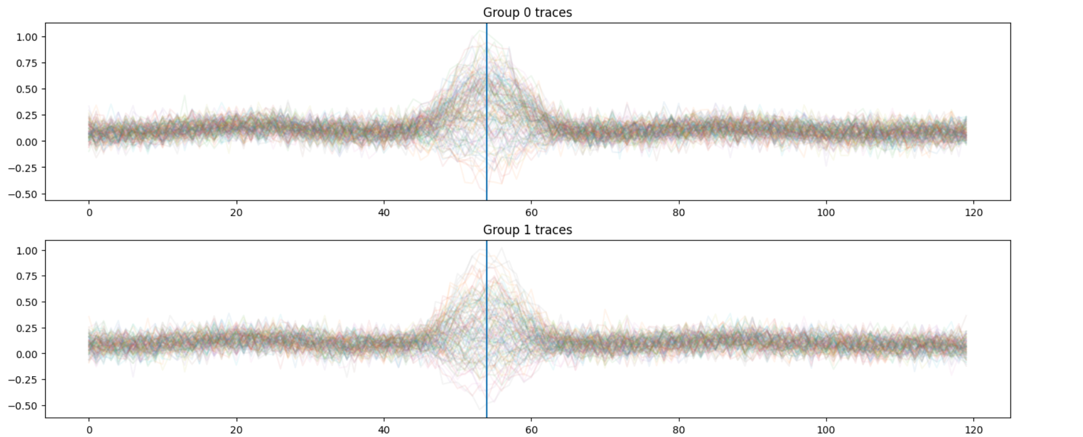
Trace Groupings

Slide 13
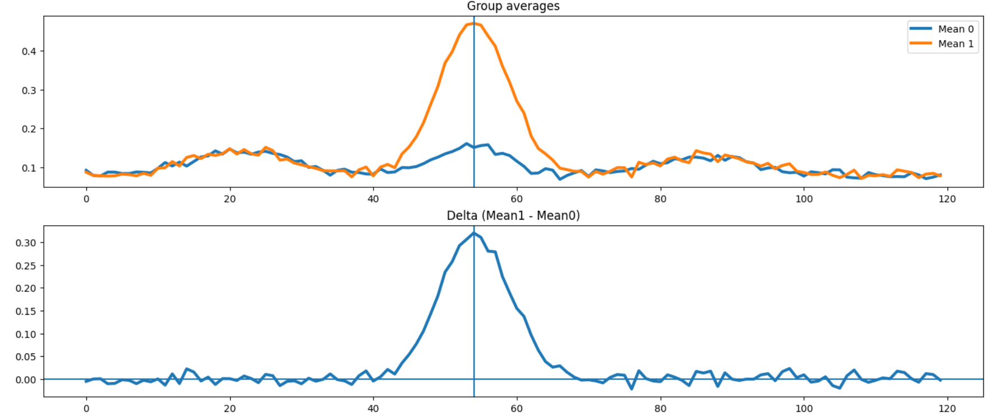
Bit == 1

Slide 14
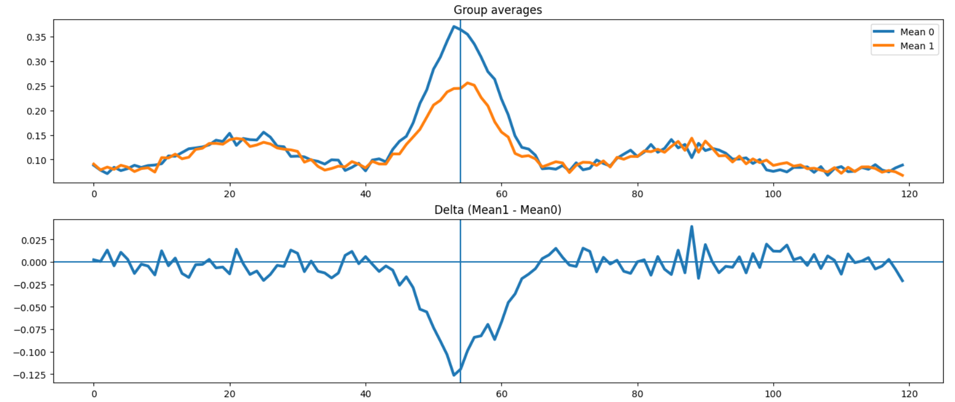
Bit == 0

Slide 15
Summary
We can determine a single bit at a point in time (attacking XOR)
Can we use this to attack actual cryptographic algorithms? Let’s look at AES next.

